Slide 1

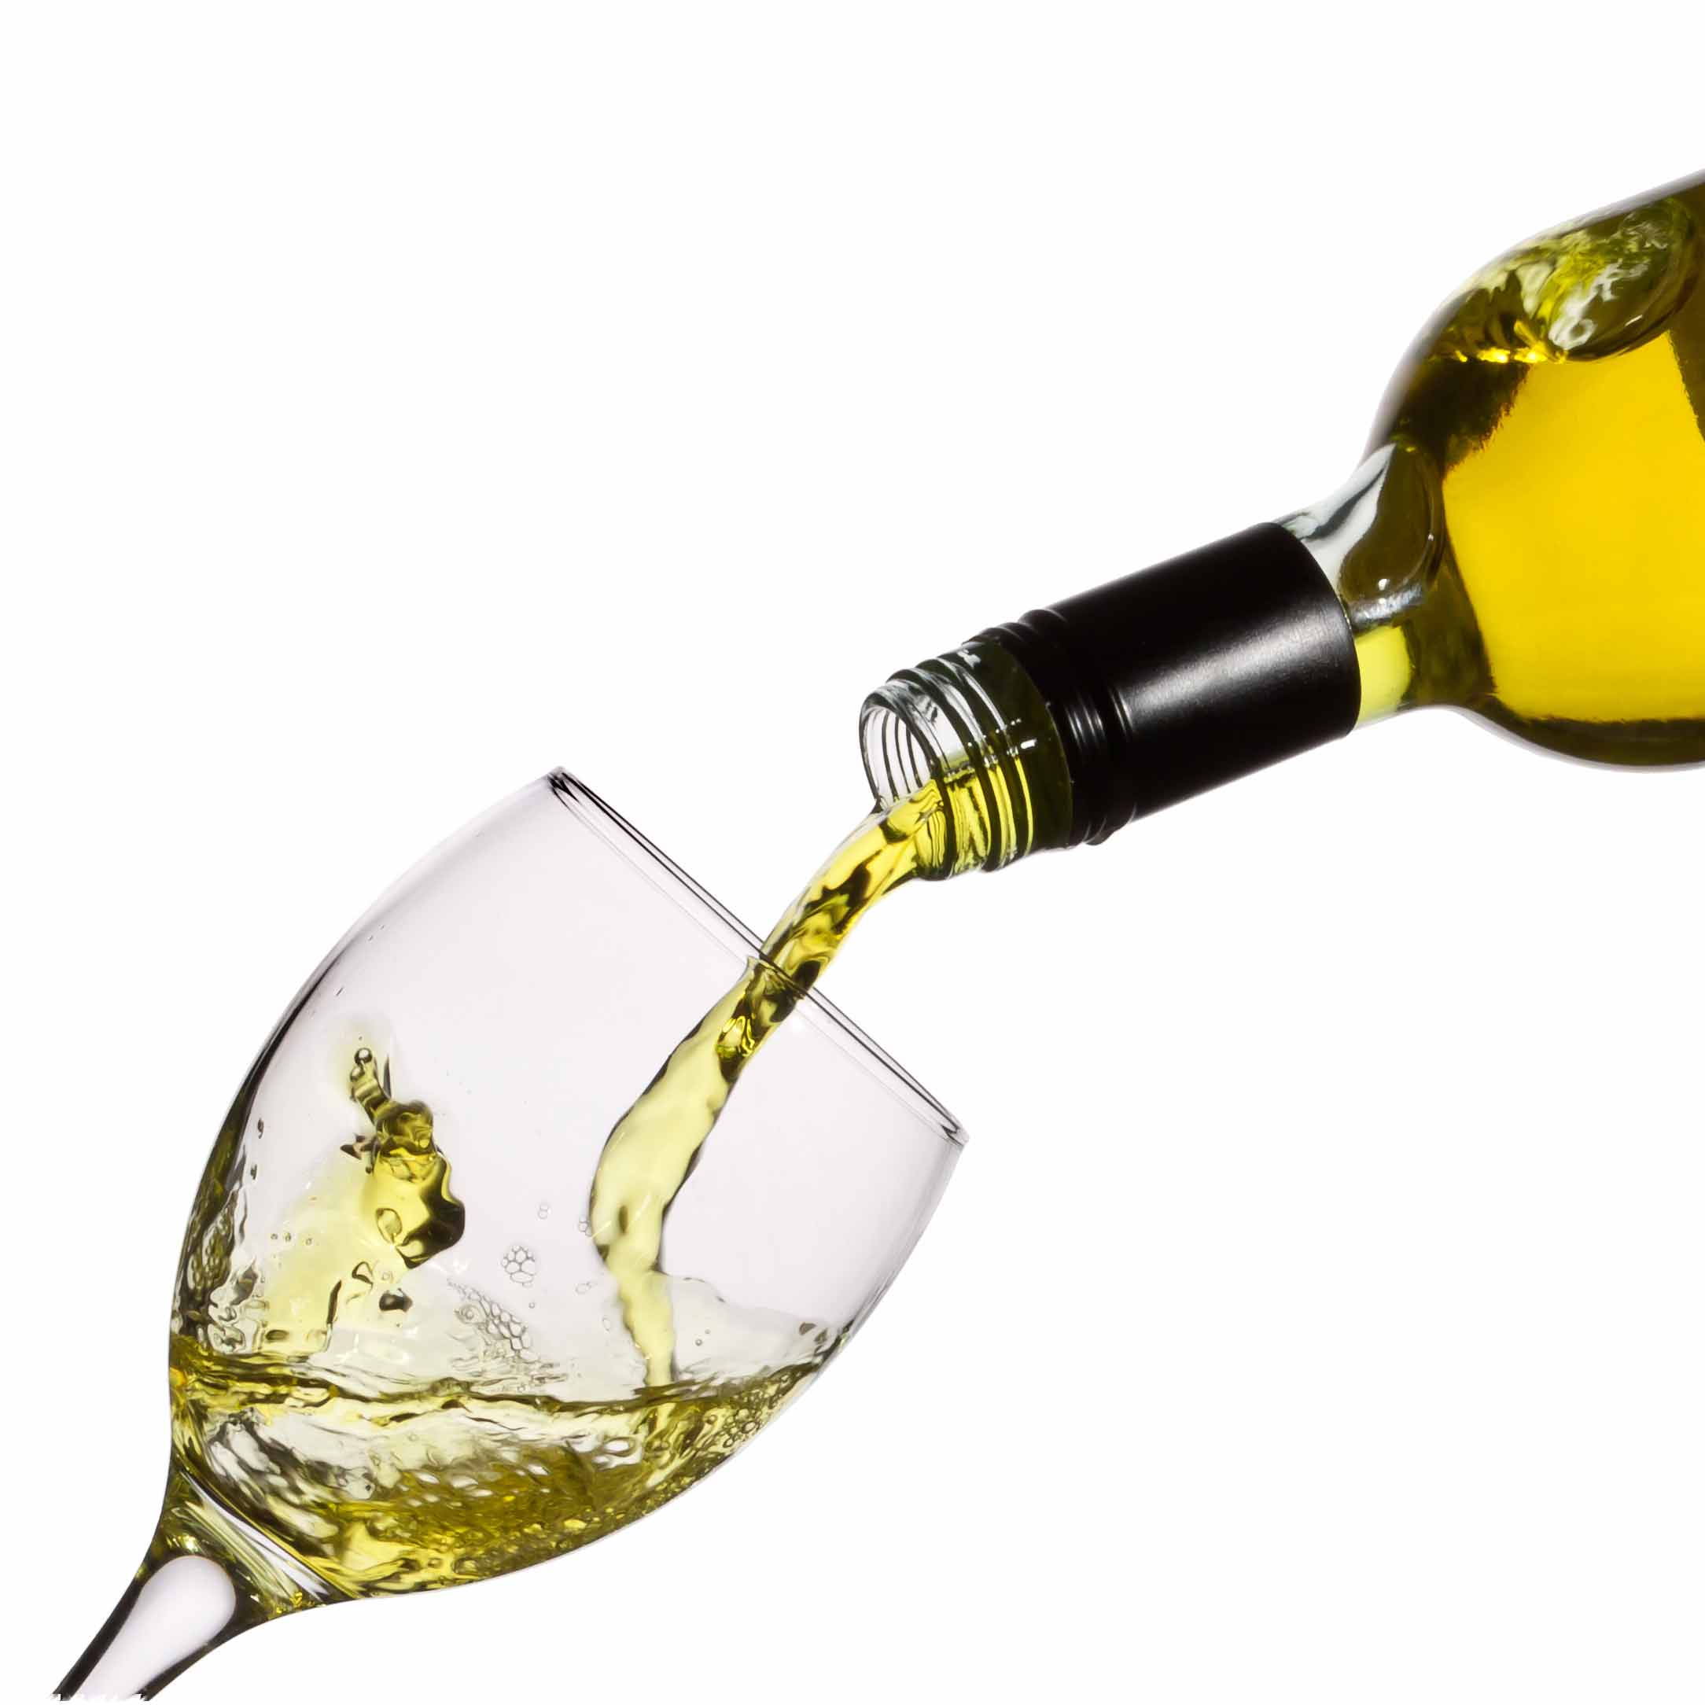
Predicting the Quality of Wine
By: Ankit Sadana

Slide 2
When selecting a drink..
What's the main factor that decides what you pick?
TASTE!
Bitter
Sweet
Sour
Dense
Smoky
and so on...

Slide 3
Things behind the taste
All the different tastes come from different ratios and percentages of things like,
Citric Acid
Sugar
Chlorides
Sulphates
pH Level
Alcohol Content

Slide 4
Datasets (UCI)
Wine Quality (Red)
# of examples: 1599
# of features: 12
Fixed Acidity
Volatile Acidity
Citric Acid
Residual Sugar
Chlorides
Free Sulfur Dioxide
Total Sulfur Dioxide
Density
pH
Sulphates
Alcohol
Quality
Wine Quality (White)
# of examples: 4898
# of features: 12
Fixed Acidity
Volatile Acidity
Citric Acid
Residual Sugar
Chlorides
Free Sulfur Dioxide
Total Sulfur Dioxide
Density
pH
Sulphates
Alcohol
Quality

Slide 5
Algorithm and approach
Algorithm being used: k-Nearest Neighbor
(range of k: 1 to size of training set)
From each dataset, training set and test set is formed by two methods,
Selecting the first 1000 (for red) or 3050 (for white) examples, i.e., first ~63% for the training set.
Randomly sampling without replacement for ~63% of the examples for the training set
And the rest of the examples are treated as a test set

Slide 6
Outputs for Sequential Sampling
Wine Quality (Red)
Wine Quality (White)

Slide 7
Citations
P. Cortez, A. Cerdeira, F. Almeida, T. Matos and J. Reis.
Modeling wine preferences by data mining from physicochemical properties.
In Decision Support Systems, Elsevier, 47(4):547-553. ISSN: 0167-9236.
Available at: [@Elsevier] http://dx.doi.org/10.1016/j.dss.2009.05.016
[Pre-press (pdf)] http://www3.dsi.uminho.pt/pcortez/winequality09.pdf
[bib] http://www3.dsi.uminho.pt/pcortez/dss09.bib

Slide 8
Thank you

